Slide 1


Post 16 EDUCATION Provision
2025-2026
Leanne Deadman

Slide 2
Make it simple but effective
WORK EXPERIENCE
EQUALS
ASSEMBLIES
OUTINGS
I’m confused !!
PLP’S
EVENTS
TOPIC
CURRICULUM
PARENTS VOICE
TRIPS

Slide 3
Our Aim
Our Post 16 curriculum aims to;
provide equal life chances as a pupil moves into adulthood
provide a holistic learning experiences
Be highly personalised, challenging and purposeful
Build upon prior learning and planned next steps
Promote pupils voice, self-advocacy, and meaningful choices for our pupils to be valued within all communities now and in the future
EHCP outcomes continue to inform pupils individual targets to reach ambitious goals
We think about our pupils interests and create links for exposure within these areas for their own individual aspirations and their futures

Slide 4
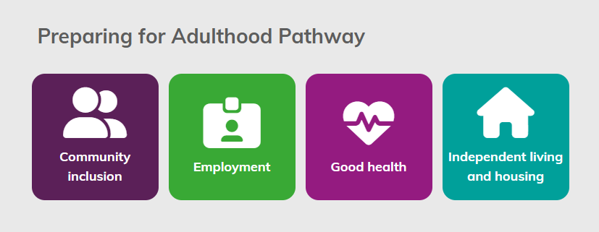
ASDAN – Lifeskills challenges
What is Lifeskills Challenge?
Lifeskills Challenge is an online bank of challenges for learners working from pre-Entry to Level 3. This programme enables centres to meet individual needs by providing a personalised curriculum for young people with SEND or those facing barriers to learning.
Challenges have been mapped to the four Preparing for Adulthood pathways and cover subject areas such as English, mathematics and PSHE.

Slide 5

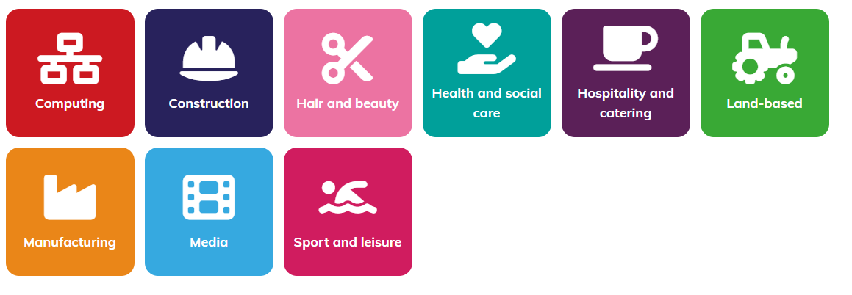

Other subjects
These subjects can also been used with the delivery of the life skills challenges and link easily to our topics. Once we have completed Life skills challenge training we can create our own challenges !
Other Subjects
Vocational area’s
Skills

Slide 6
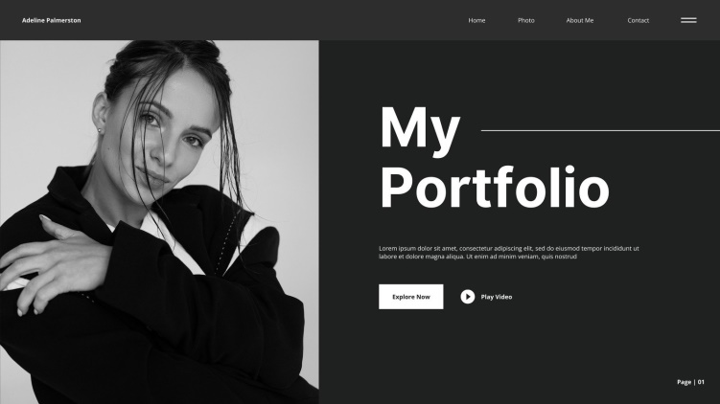
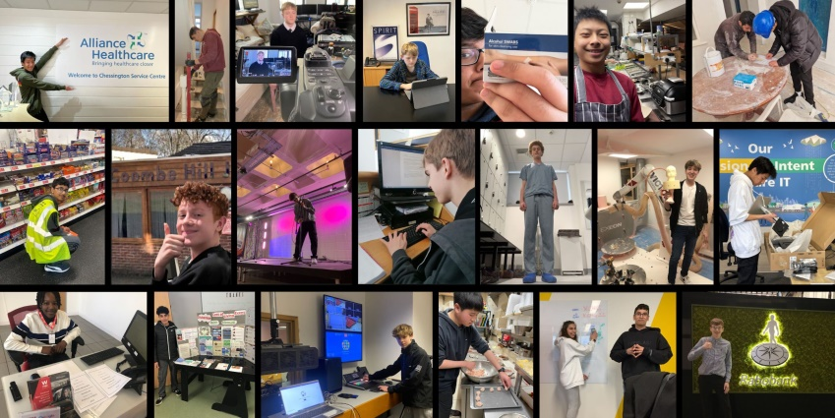
Evidence
You can work on as many or as little challenges as you like.
Each student will create a portfolio which showcases their work within each challenge they take on. This can be in what ever form the student chooses i.e. PowerPoint, paper based, videos, photos, example of work
With staff support they will also need to complete a checklist.

Slide 7

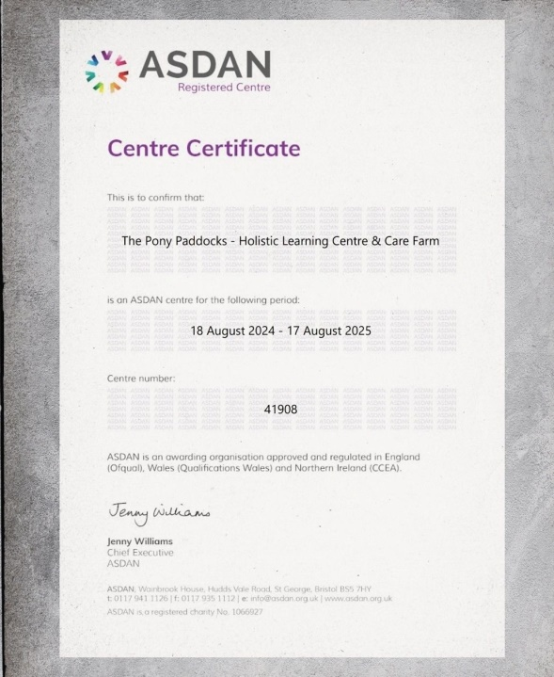
Moderation
We will need an initial quality check for our first load of evidence. Once this has been approved we will then be able to moderate in house and simply apply for certificates.
We can choose to moderate after a year or extend if we need/want to.

Slide 8
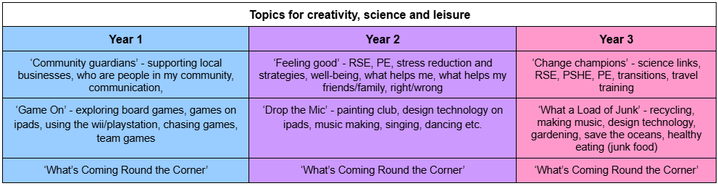
Topic cycle
This has been created to support planning not hinder.
It is easy linked to the ASDAN challenges and can also be used for the lessons listed below.
You can also utilise it for you Numeracy and Literacy.
This is NOT compulsory!!!

Slide 9
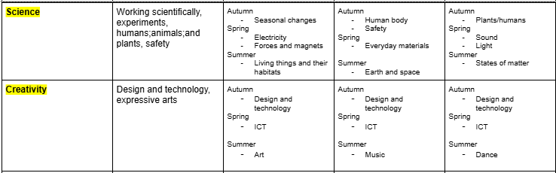
Curriculum
We have utilised information from ASDAN, the primary national curriculum and PFA. This has created a curriculum which includes the statutory subjects …
- Numeracy
Literacy
RSE
Citizenship
Creativity
Science

Slide 10
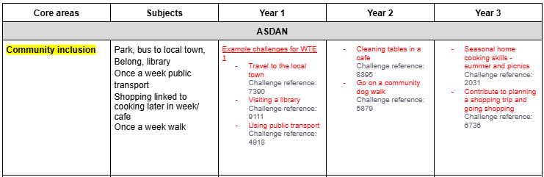
Curriculum
And our core areas linked to ASDAN which are …
Community inclusion
Good Health
Employment
Independent living and housing.

Slide 11
Links
Example of Timetable, the Topic cycle, examples of ASDAN challenges and curriculum https://docs.google.com/document/d/17PfKuxgyOvxPgjlD9sTSTR-NTmD7BIvr/edit#heading=h.r41wi980b9pq
Notes from a meeting with ASDAN which has some useful information https://docs.google.com/document/d/1AOcipXW7uvauBt8LXEaw-QHuCMmTWPuU/edit
Link to ASDAN Life skills challenge info page https://www.asdan.org.uk/lsc/challenges

